Slide 1
Retinanet
AI-Driven Multi-Class Eye Disease Detection and Classification System
GROUP 16
Palaniselvam Priyanka (Team Leader) - A0307250R
Dharshini Chellappa Chetty Rajan - A0307202X
Sweta Pattnaik - A0296537M

Slide 2
PROJECT OBJECTIVES AND SCOPE
In many developing countries, access to timely and accurate medical care remains a significant challenge, particularly in specialized fields like ophthalmology. The delays in diagnosis and limited availability of expert consultations often lead to the progression of preventable or treatable eye conditions, exacerbating the burden of vision-related disabilities.
This project is essential because it aims to bridge the gap in access to eye care by leveraging advanced technology to accelerate the detection of eye diseases by providing instant diagnosis and feedback to medical professionals and patients, even those in remote areas.
The project aims to build a robust classification system capable of identifying eye ailments and providing detailed diagnostic information. It uses machine learning and deep learning techniques to diagnose and classify various eye diseases such as Diabetic Retinopathy, Cataract, Glaucoma, etc. using retinal images.

Slide 3
DIFFERENT ARCHITECTURES AND APPROACHES IN THE PROJECT
Different architectures tried in this project to find the most suited structure:
VERSION - 1
A single classifier or model architecture where the classifier is trained on the concatenated dataset.
VERSION - 2
Four different classifiers architecture, where each classifier is trained on specific dataset.
VERSION - 3
Integrated architecture, where a single classifier with different fully connected layer heads for each disease, is trained on the concatenated dataset.
Goal of trying different architectures is to evaluate which structure gives the most efficient and best interpretable results to the users.

Slide 4
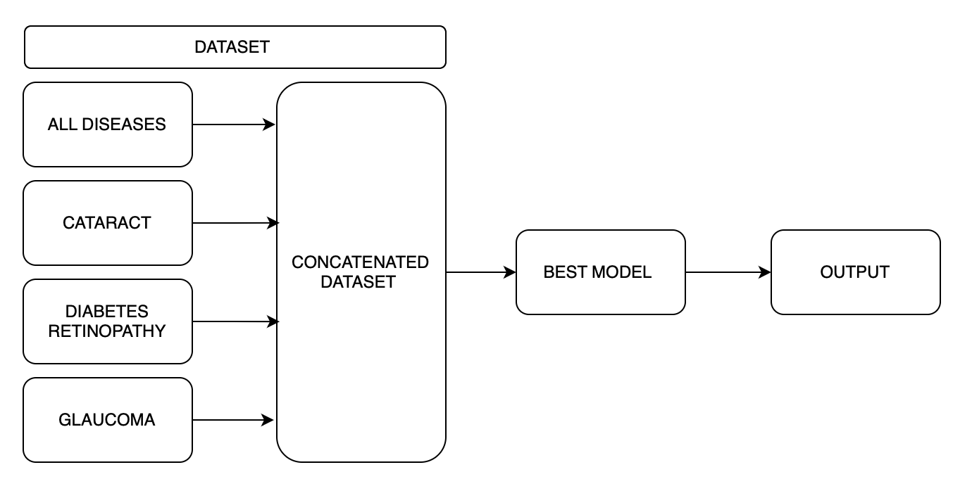
BLOCK LEVEL REPRESENTATION – VERSION 1

Slide 5
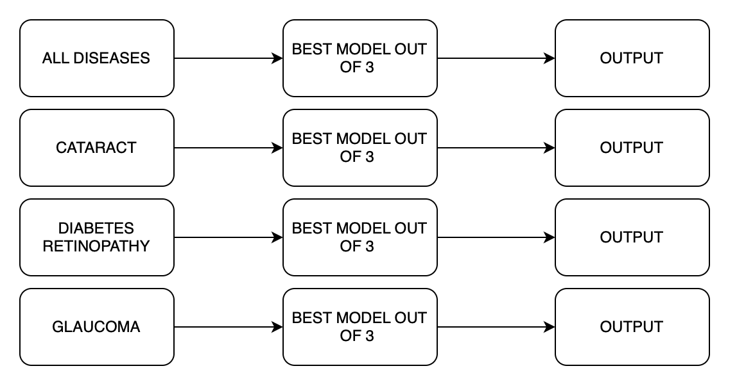
BLOCK LEVEL REPRESENTATION – VERSION 2

Slide 6
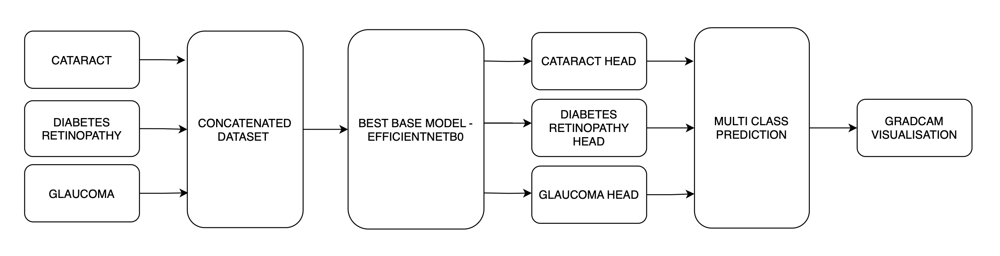
BLOCK LEVEL REPRESENTATION – VERSION 3

Slide 7
DATA REQUIRED
Four datasets are being used in this project.
The first classifier model that classifies images into different categories of eye ailments makes use of the Ocular Disease Recognition dataset. It allows us to classify the image as normal or the presence of a disease such as DR, Cataract, Glaucoma, or other ocular conditions.
The second dataset being used is the Diabetic retinopathy dataset which allows the model to classify images into no DR, mild DR, moderate DR, severe DR, and proliferative DR.
The third dataset in use is the Glaucoma Detection Dataset which allows the model to classify images into no glaucoma and glaucoma detected.
The fourth dataset in use is the Cataract dataset which allows the model to classify images into no cataract and cataract detected

Slide 8
DATA REQUIRED
1. Ocular Disease Recognition Classifier dataset :
The dataset includes a csv file and image set. The csv file consists of the ID, left-fundus and right-fundus, age, gender, diagnosis, left-diagnostic keywords and right-diagnostic keywords as columns. The dataset consists of 5000 patients, with left eye and right eye images. The ODIR-5k dataset has eight output labels for classifying ocular diseases. These labels are:
Normal (N) - 4490
Diabetic Retinopathy (D) - 2520
Glaucoma (G) - 1110
Cataract (C) - 460
Age-related Macular Degeneration (A) - 440
Hypertension (H) - 420
Myopia (M) - 360
Other Diseases (O) - 200

Slide 9
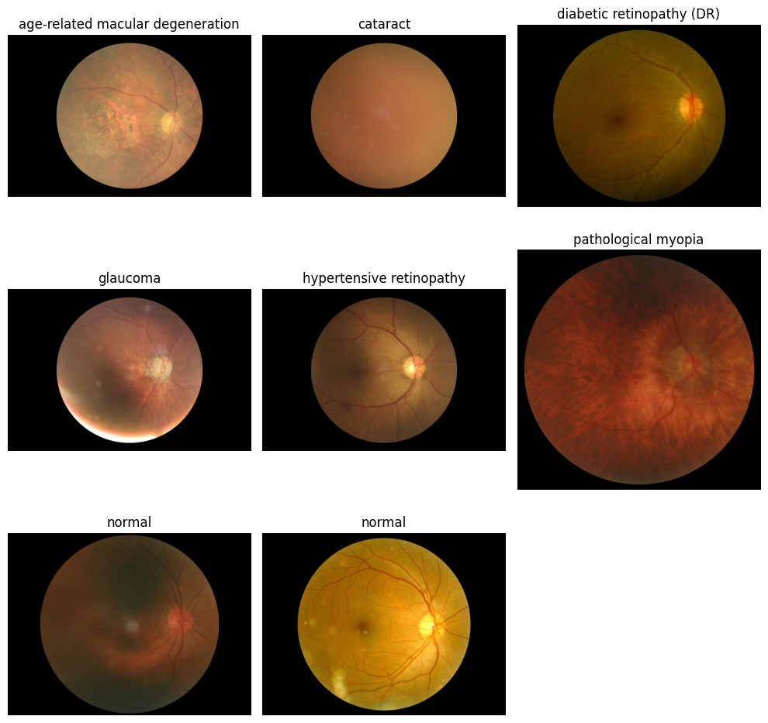
ODIR-5K images

Slide 10
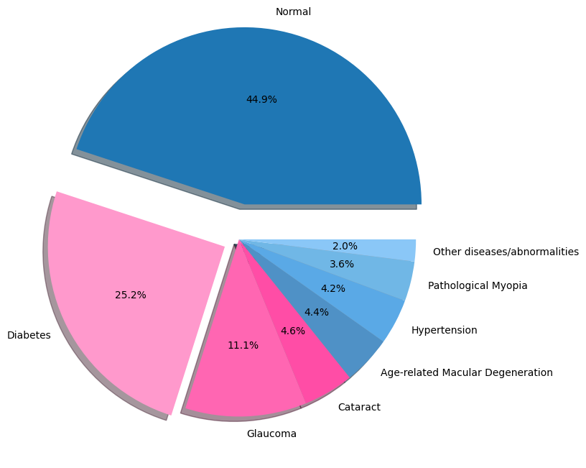
ODIR-5Kclass distribution

Slide 11
DATA REQUIRED
2. Cataract Classifier dataset:
The dataset includes images of the eye that have been labeled based on the presence or absence of cataracts.
The dataset includes two main classes:
Normal: Images of eyes without cataracts.(300)
Cataract: Images of eyes with cataracts.(100)

Slide 12
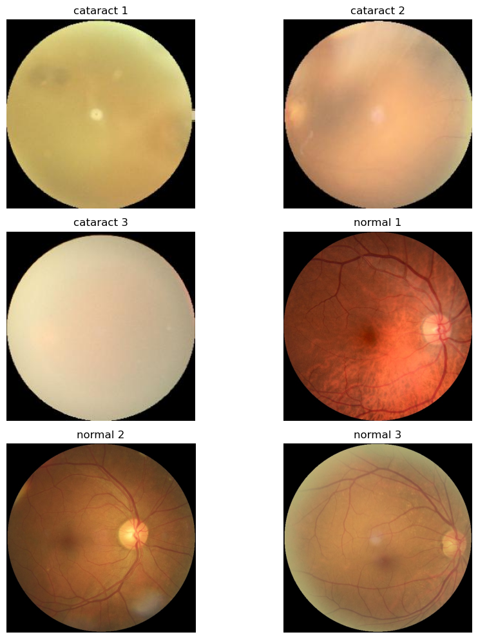
Cataract sample images

Slide 13
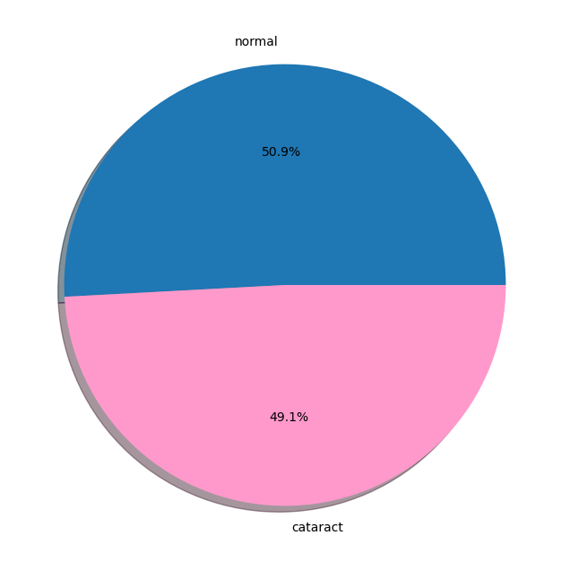
Cataract dataset class distribution

Slide 14
DATA REQUIRED
3. Diabetes Retinopathy Classifier dataset :
This data set contains fundus of the eye.
Data set size - 4 columns x 35108 rows
Distribution of images with:
No DR - 25802
Mild DR - 2438
Moderate DR - 5288
Severe DR - 872
Proliferative DR - 708
From the first hand analysis, we can see that the dataset is heavily imbalanced across the levels of DR.

Slide 15
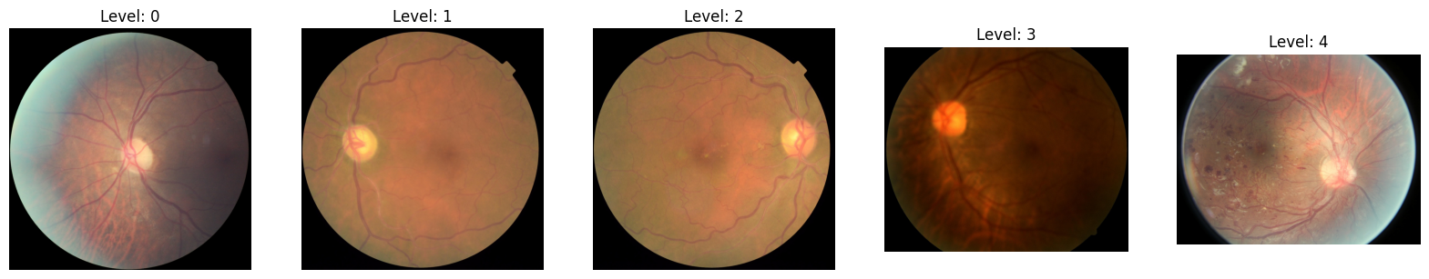
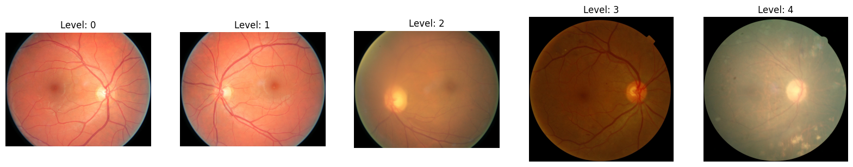
Diabetes Retinopathy Sample images

Slide 16
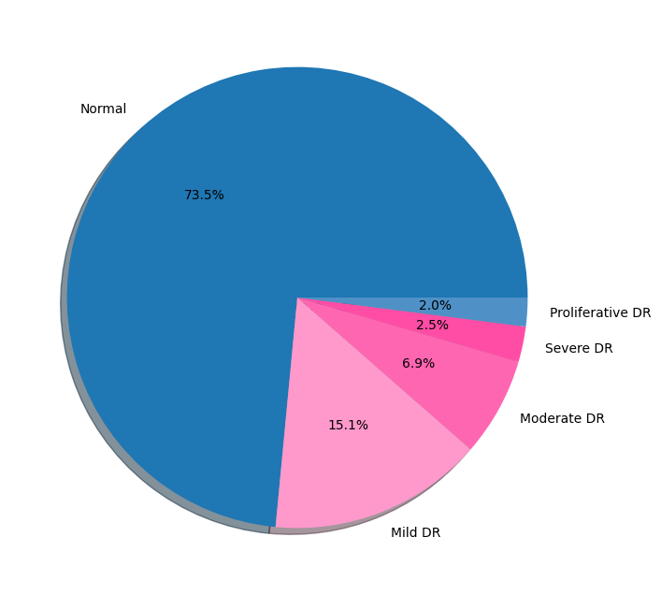
Class Distribution

Slide 17
DATA REQUIRED
4. Glaucoma Classifier dataset :
This data set contains images/oct scans of the eye in the .jpg format.
Data set size - 5 columns x 650 rows
Distribution :
Label - With Glaucoma (168)
Label - Without Glaucoma (482)
From the first hand analysis, we can see that the dataset is heavily imbalanced.

Slide 18
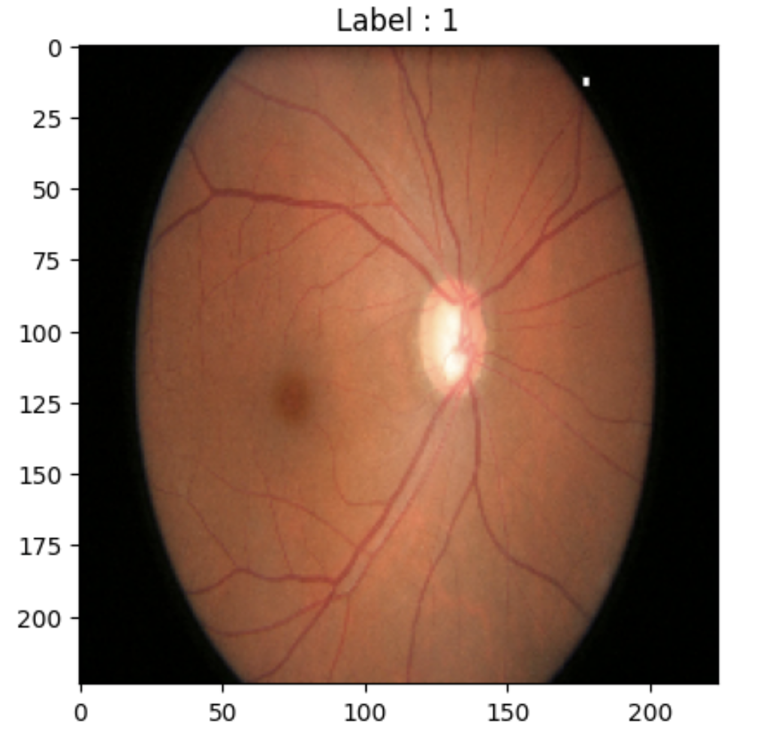
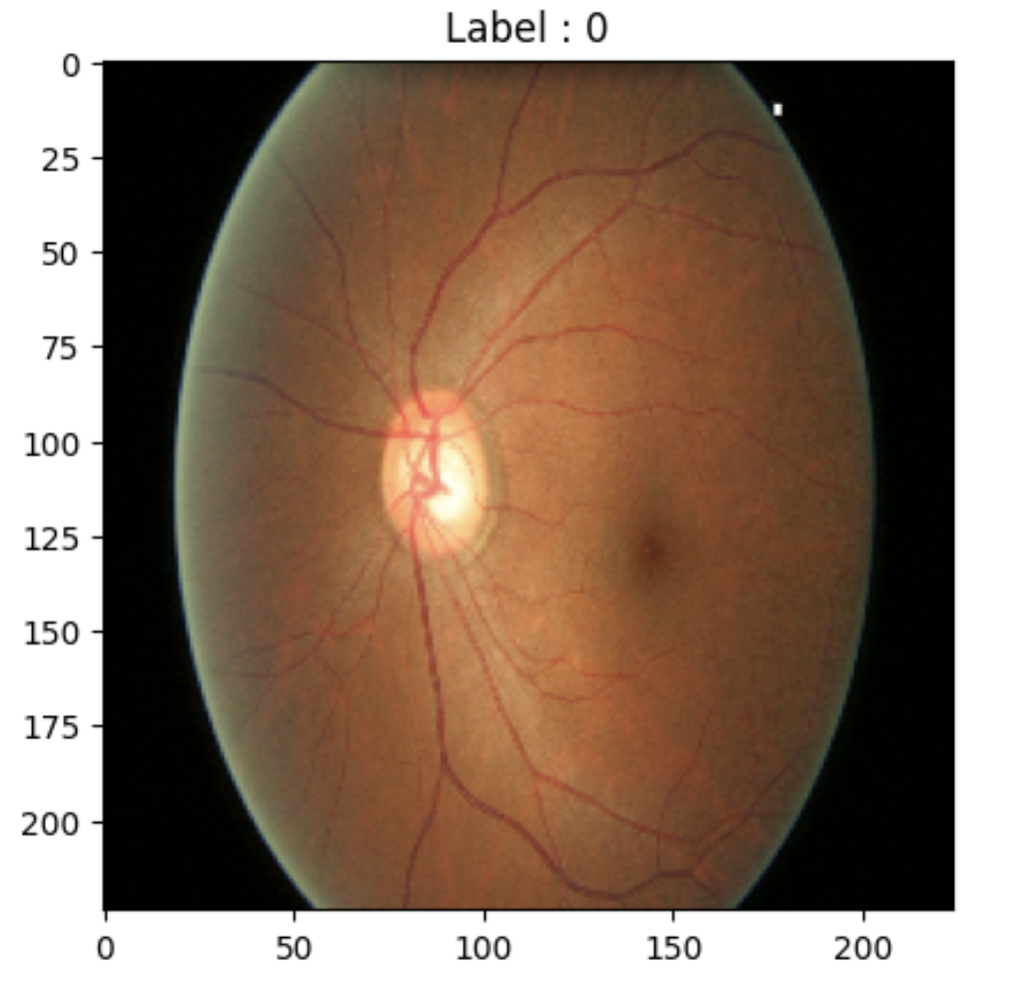
Glaucoma Classifier sample image

Slide 19
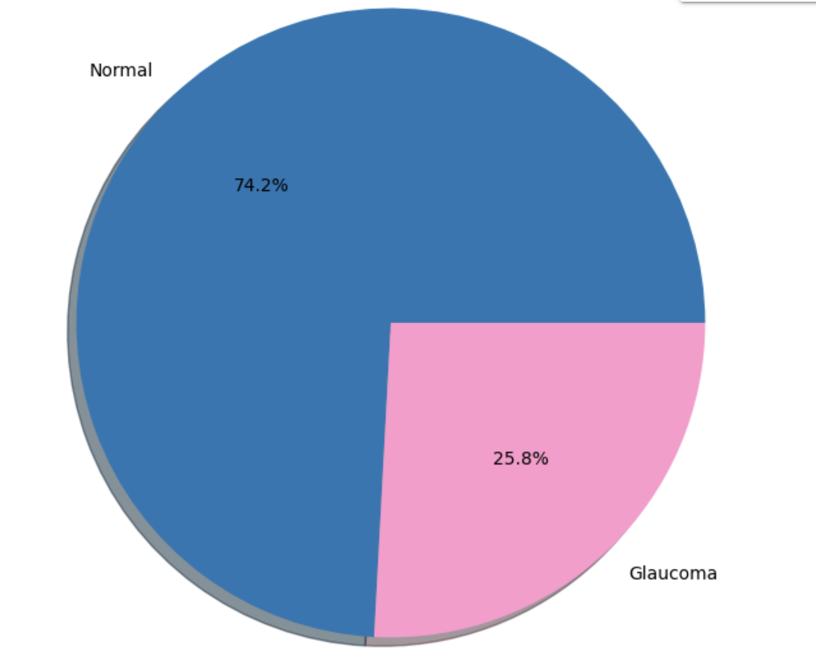
Glaucoma class distribution

Slide 20
TECHNICAL APPROACH
PREPROCESSING :
Rescaling : This line rescales the pixel values of the images from the original range of [0, 255] to a normalized range of [0, 1]. Neural networks typically perform better when inputs are normalized, and rescaling the pixel values helps the model converge faster during training.
Resizing : All images are resized to a fixed size. This ensures that the input dimensions are consistent for the network, which is important since neural networks require fixed input sizes.
Conversion to arrays : Images are converted into NumPy arrays to make them compatible with TensorFlow and Keras models. Each image will have three dimensions: height, width, and depth (3, for the RGB channels)
Also, the datasets for each of these classifiers are unbalanced, so undersampling method is used to make the datasets balanced.

Slide 21
TECHNICAL APPROACH Version - 1
1. Base classifier:
For this classifier, the following models can be used :
MobileNetV2 - A pre-trained ImageNet version of MobileNet is fine-tuned for our classification task by adding fully connected layers, enabling it to focus on disease-specific features and labels, providing a balance between performance and computational efficiency.
Xception - depth wise separable convolutions, significantly lowering computational costs while retaining accuracy, making it ideal for handling large, diverse datasets. It excels in feature extraction by separating spatial and channel information, beneficial for analyzing detailed medical images.

Slide 22
TECHNICAL APPROACH Version - 1
1. Base classifier:
Accuracy and loss
Model used | accuracy | loss
MobileNet2 | 65.43 | 155.7598
Xception | 66.02 | 139.6008

Slide 23
TECHNICAL APPROACH Version - 2
1. Base classifier - Ocular Disease recognition classifier :
For this classifier, the following models can be used :
Simple convolutional neural network (CN)
MobileNetV2 : It is a pre-trained network that is pre-trained on the ImageNet dataset, which contains millions of images classified into 1,000 categories.
Xception makes use of depthwise separable convolutions, reducing computational cost while maintaining accuracy, ideal for large and diverse datasets.
EfficientNet

Slide 24
TECHNICAL APPROACH Version - 2
1. Base classifier - Ocular Disease recognition classifier :
Accuracy and loss
Model used | accuracy | loss
EfficientNetB7 | 83.99 | 0.3873
Xception | 86.76 | 0.2170
Simple CNN | 51.35 | 1.2199

Slide 25
TECHNICAL APPROACH Version - 2
2. Cataract classifier:
Convolutional neural network(cnn) + RNN enables the model to capture spatial and sequential features, useful for analyzing medical image sequences.
EfficientNet (Transfer Learning) is highly effective for processing high-resolution medical images, helping achieve optimal performance with minimal computational cost
MobileNetV2 (Transfer learning) is lightweight and optimized for mobile devices, ideal for real-time medical diagnostics in resource-constrained environments.

Slide 26
TECHNICAL APPROACH Version - 2
2. Cataract classifier:
Accuracy and loss
Model used | accuracy | loss
EfficientNetB7 | 50.98 | 0.6934
MobileNetV2 | 98.08 | 0.0453
Custom CNN + RNN | 73.12 | 0.5147

Slide 27
TECHNICAL APPROACH Version - 2
3. Diabetes Retinopathy classifier:
MobileNetV2 – A pre-trained ImageNet version of MobileNetV2, fine-tuned for our classification task by adding fully connected layers, enabling it to focus on disease-specific features and labels, providing a balance between performance and computational efficiency.
Xception - depth wise separable convolutions, significantly lowering computational costs while retaining accuracy, making it ideal for handling large, diverse datasets. It excels in feature extraction by separating spatial and channel information, beneficial for analyzing detailed medical images.
EfficientNetB7 - ideal for high-resolution medical imaging, capturing subtle DR features with minimal computational cost. Using it as a frozen feature extractor with ImageNet weights, the model is fine-tuned with additional dense layers.

Slide 28
TECHNICAL APPROACH Version - 2
3. Diabetes Retinopathy classifier:
Accuracy and loss
Model used | accuracy | loss
EfficientNetB7 | 73.31 | 0.9647
MobileNetV2 | 73.19 | 0.8777
Xception | 87.78 | 0.2668

Slide 29
TECHNICAL APPROACH Version - 2
4. Glaucoma classifier:
For this classifier, the following models can be used :
EfficientNetB7 is a powerful variant in the EfficientNet family, optimized for balancing model accuracy and computational efficiency through a compound scaling method that adjusts depth, width, and resolution. This architecture is especially suitable for medical image analysis due to its ability to achieve high accuracy with relatively efficient processing, making it effective for handling the high resolution often required in medical imaging.
MobileNetV3Small is a lightweight neural network architecture that prioritizes speed and efficiency, originally designed for mobile applications. This model is ideal for medical imaging tasks where quick inference is critical, such as in real-time diagnostics on portable devices. Its compact architecture and depth wise separable convolutions make it an effective base model when modified with specialized output layers for medical image classification, balancing accuracy and speed for rapid and resource-efficient analysis.
ResNet50 is a deep residual network with 50 layers, known for its use of skip connections that address vanishing gradient issues, allowing for deeper architectures and better feature extraction. This capability is particularly valuable in medical imaging, where complex patterns must be learned from high-dimensional data.

Slide 30
TECHNICAL APPROACH Version - 2
4. Glaucoma classifier:
Accuracy and loss
Model used | accuracy | loss
EfficientNetB7 | 73.19 | 0.6268
MobileNetV3Small | 72.33 | 0.6644
ResNet50 | 26.32 | 0.7270

Slide 31
TECHNICAL APPROACH Version - 3
1. Integrated model
This is an integrated deep-learning model for diagnosing multiple ophthalmic
diseases using fundus images. Specifically, the task is to identify the presence of
cataracts, glaucoma, and diabetic retinopathy (DR) from a given dataset. Each
disease represents a different classification task: cataract and glaucoma are
binary classification problems
The model utilizes EfficientNetB0 as the base architecture. EfficientNet is
convolutional neural network that is highly efficient in balancing accuracy and
computational complexity. Its use here ensures high performance while being
less resource-intensive.

Slide 32
ARCHITECTURE
Base Model: The base feature extractor is the EfficientNetB0 model, pre-trained on the ImageNet dataset. Using a pre-trained model helps transfer useful visual features from a general dataset to the specific problem of fundus image classification. Transfer learning is beneficial as it allows faster convergence and better accuracy, especially with smaller datasets.
Task-Specific Heads: After extracting features using the EfficientNet base, three separate output heads are added for each classification task:
Cataract Output Head: A fully connected layer with a sigmoid activation function for binary classification of cataracts.
Glaucoma Output Head: Another binary classification head for glaucoma.
Diabetic Retinopathy Output Head: A multi-class output layer with softmax activation for classifying diabetic retinopathy severity.
These separate heads allow the network to learn multiple tasks simultaneously, leveraging shared features while optimizing each task individually.

Slide 34
Advantages of integrated model:
Shared Learning: Multiple diseases can be identified using the same set of image features. By sharing the underlying network for different disease classifications, the model benefits from feature reuse, improving generalization, and reducing overfitting.
Efficiency: Instead of training three separate models, this approach integrates them, saving computational resources and providing a more unified diagnostic tool.
Clinical Application: In practice, a single patient may need to be screened for multiple conditions. A multi-output model is better suited for such use cases, where multiple diagnoses can be made from a single fundus image in one inference step.

Slide 35
Grad-CAM implementation
Grad-CAM (Gradient-weighted Class Activation Mapping) is implemented to provide visual explanations for the model's predictions.
Grad-CAM is a crucial tool for understanding the regions in the input image that contribute the most to the model's decision-making process.
The Grad-CAM implementation involves extracting the gradients of the target output concerning the last convolutional layer's output.

Slide 36
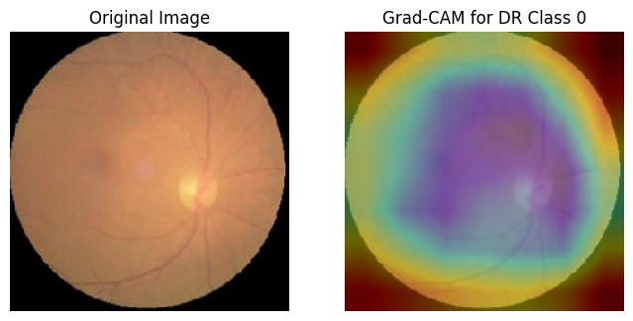

Slide 37
FLASK IMPLEMENTATION
A web interface was developed using Flask, HTML, and CSS, to create an accessible interface for diagnosing eye conditions such as cataracts, glaucoma, and diabetic retinopathy (DR) using a machine learning model. Users can upload images of eyes, receive predictions on potential conditions, and view Grad-CAM visualizations to understand which areas of the image influenced the diagnosis.
Technologies Used
Flask: A lightweight Python web framework used for rendering HTML templates.
HTML & CSS: Used to create the frontend structure and style of the web interface.
OpenCV: Used for image processing tasks, particularly for creating Grad-CAM visualizations

Slide 38
File Structure and Purpose
app.py: Main Flask application file that sets up routes for different pages, handles user uploads, and coordinates between user interactions and backend processing.
static/styles.css: Defines the web interface’s color theme and layout, ensuring a cohesive and visually appealing design across pages.
templates/: Contains HTML templates for different pages such as home.html, input.html, output.html, and gradcam.html, each providing unique functionality.
model/integrated_model.py: Loads the integrated model, defining its structure and loading weights for the eye condition detection tasks.
model/predict.py: Contains functions for image preprocessing, predicting conditions, and generating Grad-CAM visualizations.
samples/: A directory for storing user-uploaded images and Grad-CAM output images.

Slide 39
page | Function | Utility
home.html | Provides an introduction to the application and directs users to the image upload page. | Acts as the entry point for users, creating a welcoming and informative start to the diagnostic process.
input.htm | A form that accepts image uploads, which are then saved in the samples/ directory. | Collects user data for the diagnostic process and redirects to the output page after successful upload
output.html | Displays the model’s predictions, including probabilities of cataracts, glaucoma, and DR classification. | Provides feedback to the user on the model’s assessment, summarizing the diagnostic results.
gradcam.html | Shows Grad-CAM output, highlighting areas of the uploaded image that the model used for its classification | Offers transparency to users by visually explaining how the model made its diagnosis, which enhances interpretability

Slide 40
Models used
Model Integration and Loading (integrated_model.py):
The file defines and loads a pre-trained model architecture specifically designed for multi-task learning. The model’s weights are loaded from an h5 file, ensuring it’s ready for inference when the server is running.
Image Prediction and Grad-CAM Generation (predict.py):
Image Preprocessing and Prediction: process_image() handles the image processing. It resizes, scales, and normalizes the image, passing it through the model to obtain probabilities for cataracts and glaucoma and a classification for diabetic retinopathy.
Grad-CAM Visualization: generate_gradcam() creates a Grad-CAM image by computing gradients concerning the target class. Using OpenCV, the Grad-CAM heatmap is overlaid on the original image to produce a final visualization, saved in the uploads/ directory for display on the Grad-CAM page.

